Slide 1

Red Wine Quality Analysis
Prepared By Deepakshi Mahajan

Slide 2

Goals and Objectives
To Identify the factors which influence the Quality of wine.
To identify relationship between acidic content and various other features
To Suggest analytical solution and recommendations for the better quality of Wine.

Slide 3

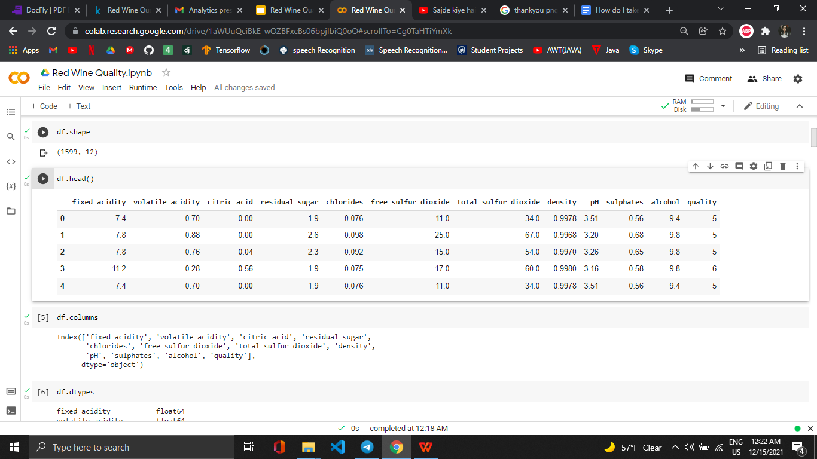
About DataSet
This dataset is related to red variants of the Portuguese "Vinho Verde" wine. It contains 12 variables and the target attribute is quality which helps you to decide which wine is better.
Quality varies from 0(low). - 10(high) scale, thus it is an ordinal variable. Hence to determine the quality variable of a wine, it would be a case of classification problem.

Slide 4
Dataset Variables
fixed acidity - that will not evaporates
volatile acidity - amount of acetic acid in wine
citric acid- add freshness and flavor to wine
residual sugar - Remaining sugar(in gram/litre)
chlorides - the amount of salt in the wine
free sulfur dioxide - the free form of SO2
total sulfur dioxide - amount of free and bound forms of S02
density - the density of water is close to that of water depending on the percent alcohol and sugar content
pH - most wines are between 3-4 on the pH scale
sulphates - SO2 level
alcohol - alcohol content of the wine
Quality - target variable

Slide 5
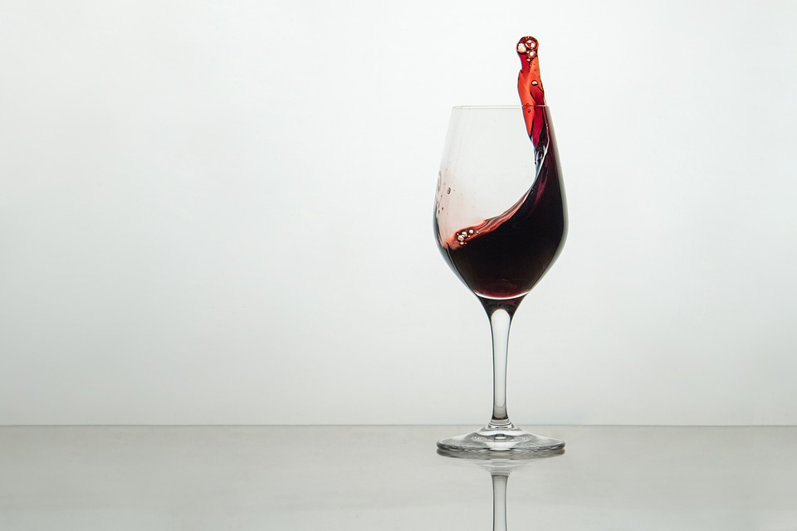
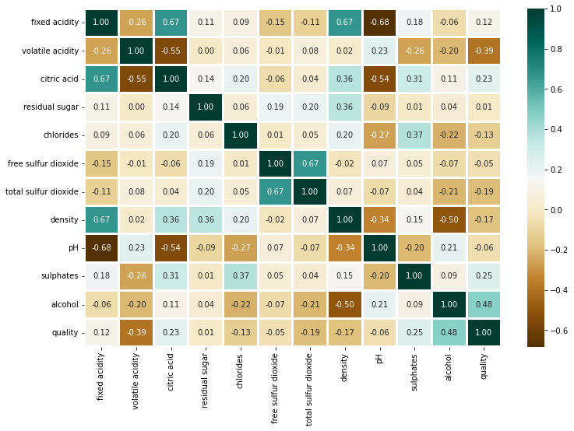
Exploratory Data Analysis
Is there any correlation among variables???
Insights
Alcohol seems to be most explanatory when it comes to quality ratings
pH is -vely correlated with fixed acid and volatile acid (ph = -log(acid conc))
Citric acid and fixed acid are +vely correlated.

Slide 6

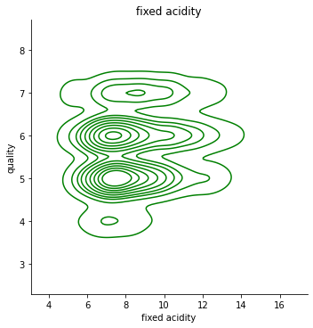
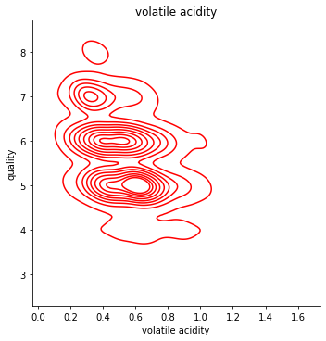
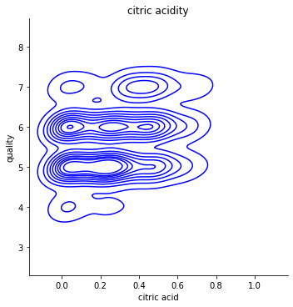
Exploratory Data Analysis
How acidity of wine affects its quality???

Slide 7

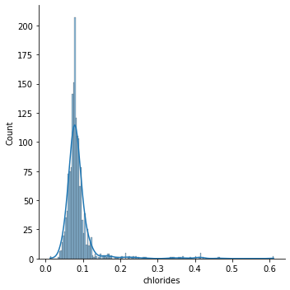
Exploratory Data Analysis
Chlorides seem to be centered around 0.1

Slide 8

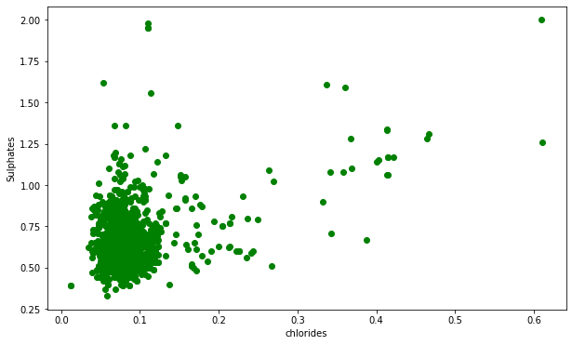
Exploratory Data Analysis
Relation Between Chloride and Sulphates Extent in Wine
Most values of the Chloride Extent lies in the range of 0-0.3 and Sulphates Extent lies between 0.25-1.25

Slide 9
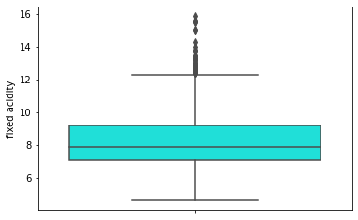
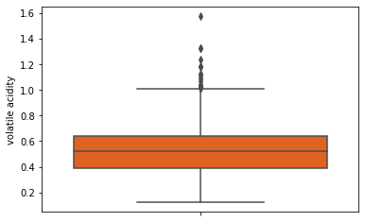
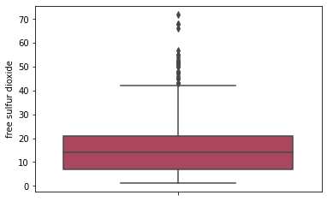
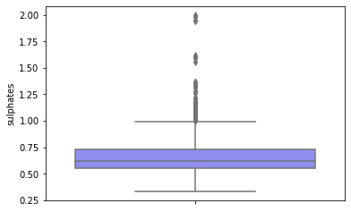
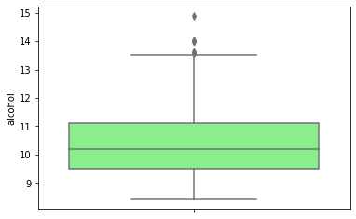
OUTLIERS

Slide 10

Outliers Key Points
Mean residual sugar level is 5.4 g/l, but there is a sample of very sweet wine with 65.8 g/l (an outlier).
Mean free sulfur dioxide is 30.5 ppm. Max value is 289 which is quite high as 75% is 41 ppm.
PH of wine is within range from 2.7 till 4, mean 3.2.
Datasets with fixed acidity values > 12 can be neglected

Slide 11
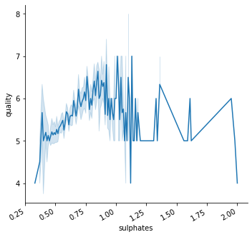
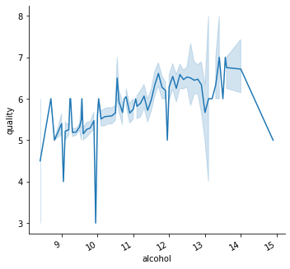
Quality vs Significant attributes
The graph clearly shows that sulphate is positively correlated with quality of wine.
The graph clearly shows that greater the extent of alcohol , better the quality of the wine.

Slide 12

Conclusions
We observed greater the extent of alcohol , better the quality of the wine. For ex : Wine with high alcohol percentage has quality level 7, wine with less alcohol percentage is quality level 5
When alcohol percentage decreases, density grows.
When fixed acidity increases density of red wine increases as well.
Total sulfur dioxide and level of residual sugar are positively correlated.
Wine density and residual sugar level have positive correlation.

Slide 13

Thankyou

